Slide 1
zekeLabs
Learning made Simpler ! www.zekeLabs.com

Slide 2


Slide 3
Kubernetes : Services
info@zekeLabs.com | www.zekeLabs.com | +91 8095465880

Slide 4
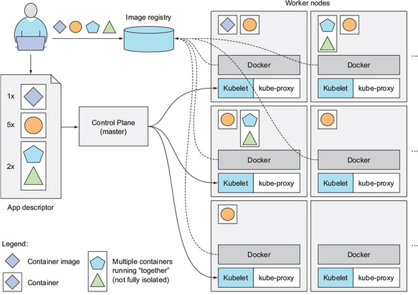
How Kubernetes works ?
info@zekeLabs.com | www.zekeLabs.com | +91 8095465880

Slide 5
Service
A Kubernetes Service is a resource you create to make a single, constant point of entry to a group of pods providing the same service.
Each service has an IP address and port that never change while the service exists.
Clients can open connections to that IP and port, and those connections are then routed to one of the pods backing that service.
This way, clients of a service don’t need to know the location of individual pods providing the service, allowing those pods to be moved around the cluster at any time.
NO dependency on IP address or name of pod, services are identified by name of the service.
Look into kubia-svc.yaml

Slide 6
Service
In the service.spec (kubia-svc.yaml) :
port: The port this service will be available on, for clients
targetPort The container port the service will forward to
All pods with the app=kubia label will be part of this service.

Slide 7
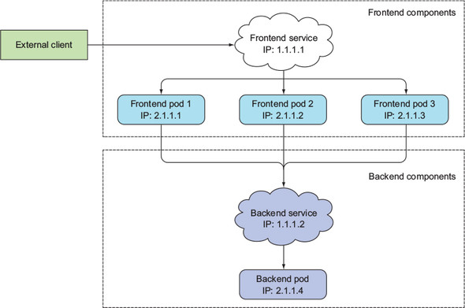
How Services work ?
info@zekeLabs.com | www.zekeLabs.com | +91 8095465880

Slide 8
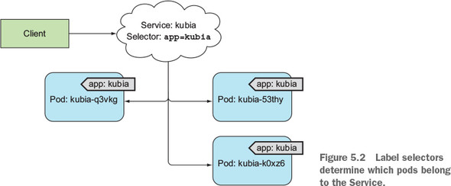
labels define the association
info@zekeLabs.com | www.zekeLabs.com | +91 8095465880

Slide 9
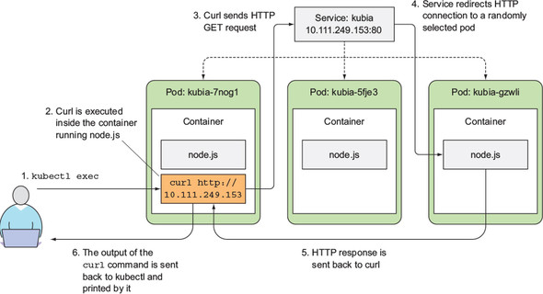
labels define the association
info@zekeLabs.com | www.zekeLabs.com | +91 8095465880

Slide 10
Session affinity
Kubernetes supports only two types of service session affinity: None and ClientIP.
It doesn’t have a cookie-based session affinity option, because Kubernetes services don’t operate at the HTTP level.
Services deal with TCP and UDP packets and don’t care about the payload they carry.
SessionAffinity:ClientIP makes the service proxy redirect all requests originating from the same client IP to the same pod.
kind: Service spec: sessionAffinity: ClientIP ...

Slide 11
THANK YOU
Let us know how can we help your organization to Upskill the employees to stay updated in the ever-evolving IT Industry.
Get in touch:
www.zekeLabs.com | +91-8095465880 | info@zekeLabs.com
Visit : www.zekeLabs.com for more details

